Slide 1
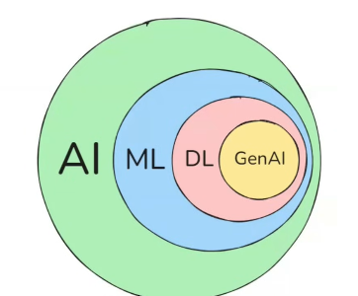

π
Neural Network
Neural network & History
Neural Network –How it works
Component of Neural network
Activation Function
Backward error propagation
Time Series Data
ANN,CNN,RNN
ANN
Neural Network-Layman term
RNN
Type of RNN
Problem with RNN
LSTM
Notes:
Content: https://www.linkedin.com/pulse/chunking-strategies-ai-data-kash-kashyap-0lghe/

Slide 2
1
2
3
Gradient Descent
Loss /Cost Function
Time Series
Relu
TanH
Vanishing Gradient Problem
Learning Rate
Sigmoid
feed forward NN

Slide 3
Puzzle
let's solve the puzzle
300
1
3
2
puzzle have 3 pieces or component. let us say answer of this is 300. when we solve this from different component answer is 280
Puzzle
1
3
280
20 -Error
2
20 error is not coming for individual component but it is coming from collectively from all component(piece)
Puzzle
10
Puzzle
There is also possibility 1, 2 component generating less error but 3 is most like 18
4
6
There is possibility 10 error coming from piece-1,
6 from piece-2 and 4 from piece-3
2
18
1
3
0
2
1
3
2
280
20 -Error
Notes:
Content: https://www.linkedin.com/pulse/chunking-strategies-ai-data-kash-kashyap-0lghe/

Slide 4
When we solve different pieces of a puzzle and combine them to reach a final result, this process, in the world of neural networks, is called Forward propagation(FP)
At the moment​ when we see an​y error ​,we go back and try to see which part of the puzzle is giving error and try to optimize the ​c​components . This process is called Backward propagation(BP)
What is the purpose of artificial Neural Network
mimic the behavior of Human brain
Neurons are basic building block of Human.
Notes:
Content: https://www.linkedin.com/pulse/chunking-strategies-ai-data-kash-kashyap-0lghe/

Slide 5
Perceptron – Layman term
Perception
1950
x1
o/p
Perception as a concept was theoretically conceived in 1950
x2
The purpose of it to
- To create a machine?
- To create a System?
- To create a gate which can take multiple input and give one output?
x3
Simple perceptron
x1
1/0
x2
x3
x1+x2+x3 > threshold
1
x1+x2+x3>threshold
0
Notes:
Content: https://www.linkedin.com/pulse/chunking-strategies-ai-data-kash-kashyap-0lghe/

Slide 6
Let’s take a real life example ,the job of it to predict someone have diabetes or not
x1
age
Let us ​​established a formula that predicts whether a person has diabetes or not, but the problem of binary perception is ,it does not provide more flexibility to give more input.
Because It is not mandatory we can calculate person have diabetes or not based upon age,height,weight
Height
1/0
x2
weight
x3
Real-world problems are more complex. Based on these perceptions, the concept of neurons are developed. Neurons are nothing but a sophisticated perception.
x1
w1
P1
w2
x2
w3
x3
N1
N1
Multiple neurons come together to perform a particular job, that process or structure is called neural network
Notes:
Content: https://www.linkedin.com/pulse/chunking-strategies-ai-data-kash-kashyap-0lghe/

